Slide 1
Application of the Complex Event Processing system for anomaly detection and network monitoring
Marek Pawłowski, Gerard Frankowski, Marcin Jerzak, Maciej Miłostan, Tomasz Nowak
Poznań Supercomputing and Networking Center
Notes:
Good afternoon. My name is Marek Pawłowski. I am from Poznań Supercomputing and Networking Center and I will present you SECOR - Application of the Complex Event Processing system for anomaly detection and network monitoring.

Slide 2
Agenda
Introduction
System Architecture
Blocks of Analysis (BAs)
Petri nets
Machine learning
Neural networks
Graph Clustering algorithms
Statistical anomaly detection
WSO2
Notes:
This is the agenda(edżnda) of our short talk. The main technical points will be the SECOR(s i si oł ar) architecture, description of different Blocks of Analysis and using the WSO2(dabliu s oł tu) framework in our project.

Slide 3
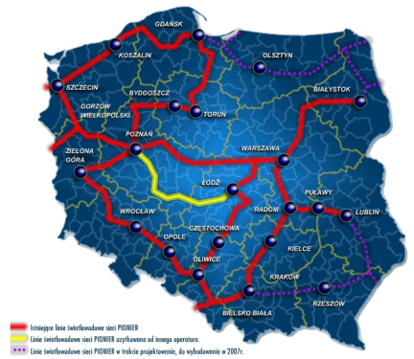
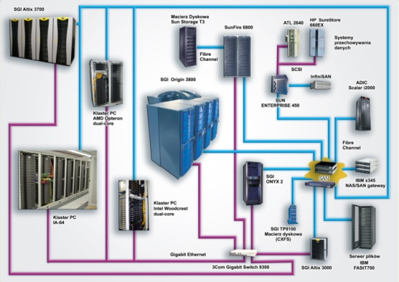
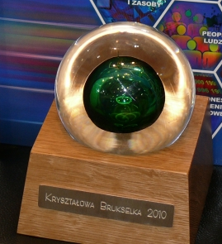
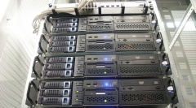
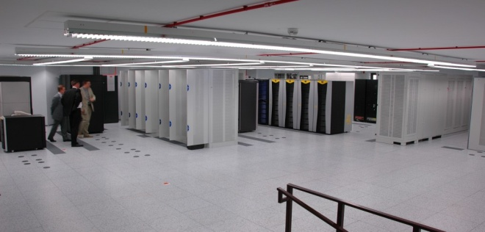
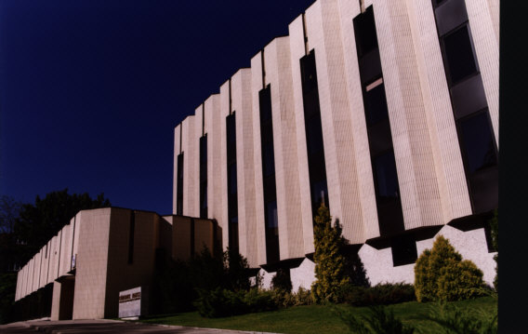
PSNC
Operator of Polish NREN – PIONIER and POZMAN networks
Participant of EU-level and national R&D Projects
R&D activities together with science, education, administration and business
Main areas of interest:
New Generation Networks
New data processing architectures
Advanced applications
IoT services
Security of networks and systems
Notes:
But first let me introduce where I come from. PSNC(pi s n si) is a research center affiliated by Institute of Bioorganic Chemistry of Polish Academy of Sciences. This is the operator of Polish National Research and Education Network – PIONIER[pajonijer]. We participate in many European and Polish research projects, but also cooperate with research, education, administration and business. Our main areas of interest are: new generation networks, new data processing models, Internet of Things and security – I am from Security Team in PSNC, so the last topic is the most familiar to me.

Slide 4
The SECOR Project
SECOR – Sensor Data Correlation Engine for Attack Detection and Support of the Decision Process
Applied Research Programme (PBS) of the National Centre for Research and Development (NCBiR)
December 2012 – May 2015
The Consortium:
Military Communication Institute (WIŁ)
Poznań Supercomputing and Networking Center
ITTI Sp. z o.o.
Notes:
SECOR is an acronym to a longer name you can see on the slide. This is a national project. The project consortium consists of Military Communication Institute (they coordinate the project), PSNC and an SME(s m i) company – ITTI(aj ti ti aj). The project finishes in May. The main goal of the project is to build different models of anomaly detection and to correlate their results. Different partners take care of particular anomaly detection approaches.

Slide 5
Agenda
Introduction
System Architecture
Blocks of Analysis (BAs)
Petri nets
Machine learning
Neural networks
Graph Clustering algorithms
Statistical anomaly detection
WSO2
Notes:
Now I would like to say a few words about the architecture of the system.

Slide 6
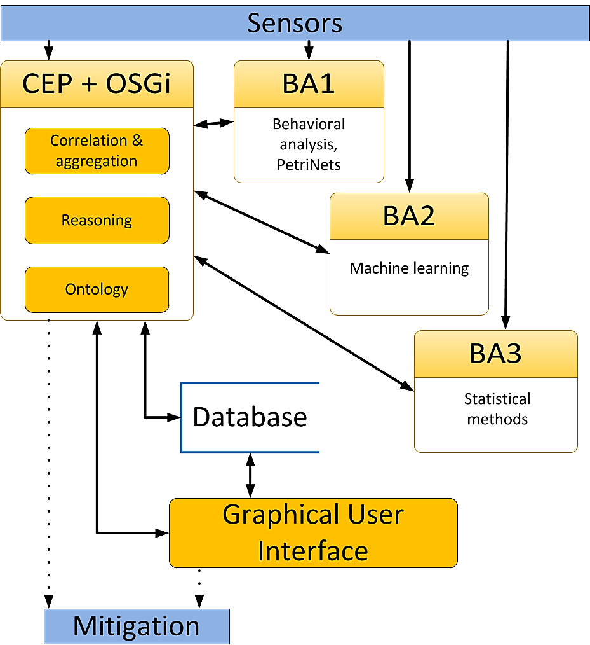
System Architecture (1)
Notes:
This is the general SECOR architecture.
Definition of terms:
BA(Analysis block) – is a program with can analysis data from sensors to search anomaly or attacks,
CEP(Complex Event processing) - is event processing from many different source to analysis data,
Database – storage for all detected anomaly's and cyber attacks,
GUI – web application for manage other module of system.
Sensors is the element of system denoting all used by the system data source. In this group there are elements which give information for each block analysis. This refers to the variety of sources - from information from various external systems IDS, the data from the switches and network routers.
Sensor may be the network device, computer program, or any different source of information about network communication, system behavioral, file activity or any other.
This is the general SECOR architecture. As you can see, there is a number of BAs (Blocks of Analysis). Each project partner works on particular BA. We take care of the BA2, where we implement anomaly detection methods using graph clustering algorithms and neural networks. Output from particular BAs are sent to the CEP – Complex Event Processing module that is able to correlate them. All information about the processed events and correlation results are stored in the local database. The whole system may be managed by a Web-based administration interface. As you can see, SECOR accepts data from sensors – the data may be sent directly to the CEP module or to BAs. The system outputs information about detected threats which may be then mitigated either automatically or manually (by actions performed by the SECOR administration in the management application).

Slide 7
System Architecture (2)
Notes:
As you can see, there is a number of BAs (Blocks of Analysis).
Each project partner works on particular BA.
We take care of the BA2, where we implement anomaly detection methods using graph clustering algorithms and neural networks.
Output from particular BAs are sent to the CEP – Complex Event Processing module that is able to correlate them.

Slide 8
System Architecture (3)
Blocks of Analysis (BAs)
BA1: behavioral analysis, Petri nets
BA2: machine learning
Neural networks
Graph clustering algorithms
Machine learning
BA3: statistical methods
Notes:
In our project has been applied many solutions to detect anomalies / attacks in the network or operating systems.
Some of them are: //
In PSNC we develop Blocks of Analysis based on neural networks and graph clustering algorithms. I will decribe these components in more details.

Slide 9
System Architecture (4)
Notes:
CEP is most important module of system because can processed and compare result from block of ananlysis. In SECOR our CEP is WSO2 (dabliu s oł tu) with Siddhi(sadi) engine with have Siddhi(sadi) query language. I speak more about this on end of presentation. Any block of analysis was built on OSGi framework and run as OSGi bundle. Thanks to this solution we can easily management all of components and we can add new modules if we want to without reset or shutdown all system.

Slide 10
System Architecture (5)
Notes:
Data base is a storehouse with information about detected cyber-attacks and anomalies from CEP or data from system administrators put in by user application. Performance reasons will not be stored in the database, partial data from various sensors or blocks analysis. They include only the information which has been previously processed, signature, and history data about earlier attacks. The has an extra feature may use to save and store logs data from all blocks of system.
In Database we keep information about attacks or anomalies. We aren't stored all data from sensor because is to much information form network or system activity. And the most important our system use artificial intelligence based on learned patterns (not use not processed data).

Slide 11
System Architecture (6)
Notes:
The application is called as graphical user interface it is a management graphic panel for security administrator. By means of GUI application we can administer else component in system like CEP or BA. Application is show the all special selected information about system and any cyber-attacks or issues.

Slide 12
Agenda
Introduction
System Architecture
Blocks of Analysis (BAs)
Petri nets
Machine learning
Neural networks
Graph Clustering algorithms
Statistical anomaly detection
WSO2
Notes:
Now I want to say more about analysis blocks. (WIŁ)
First is Block of analysis with solution based on ontology and petri nets.

Slide 13
Blocks of Analysis – Ontology and Petri nets
Detects: malware
Which attacks are detected: malware
Sensors: Process Monitor (Sysinternals) [system file activity, system registry, process and services activity, network communication]
Data: Process Index, Time of Day, Process Name, PID, Operation, Path, Result, Detail
Notes:
Block of Analysis mostly detect malware software in behaviors of Windows operating system.
The main attack with is detected is malware.
Sensor is Process Monitor it is one of the Sysintenals packet programs.
Block of Analysis uses all the data that has been written on the slide.

Slide 14
Agenda
Introduction
System Architecture
Blocks of Analysis (BAs)
Petri nets
Machine learning
Neural networks
Graph Clustering algorithms
Statistical anomaly detection
WSO2
Notes:
Next Block analysis from our list is modul with solution based on machine learning.(ITTI)

Slide 15
Blocks of Analysis – Machine learning
Detects: anomaly/attacks in network traffic
Which attacks are detected: SQL Injection, XSS, attacks on application layer
Sensors: SNORT, TCPDump, NGREP, ICD, PHP-IDS, GreenSQL, SCALP
Data:
Transport layer (WWW services connections)
Application layer (HTTP protocol)
Application layer logs (data in the filesystem)
Notes:
Block of Analysis detect anomalies and attacks in network traffic.
BA detect attack such as SQL-Injection, XSS(ex s s) and attacks on application layer.
BA use many sensors like SNORT and others show on slide.
Block of Analysis uses data like …

Slide 16
Agenda
Introduction
System Architecture
Blocks of Analysis (BAs)
Petri nets
Machine learning
Neural networks
Graph Clustering algorithms
Statistical anomaly detection
WSO2
Notes:
Third of BA(be ej) from our list is modul with solution based on neural networks.

Slide 17
Blocks of Analysis – Neural networks (1)
Detects: anomaly/attacks on operating system
Which attacks are detected: changed code in memory, incorrect activity of replaced binaries
Sensors: strace
Data: syscall (system calls)
Notes:
Block of Analysis detect anomalies and attacks on operating system.
BA detect attack such as changed code in memory, incorrect activity of replaced binaries and many others.
Sensor of BA is strace(strejs).
Block of Analysis uses syscall data to analysis.

Slide 18
Blocks of Analysis – Neural networks (2)
System calls
Altered code in memory even if the binaries on disk are left intact
Networks trained on genuine binaries
Notes:
Neural networks predict behavior of running processes by monitoring system calls.
Thus(tas) it provides means of detecting altered code in memory even if the binaries on disk are left intact.
Networks trained on genuine binaries detect anomalous activity of replaced binaries - expected system call series are very different. Publicly accessible data sets of system calls were used to evaluate different algorithms and choose the best performers.

Slide 19
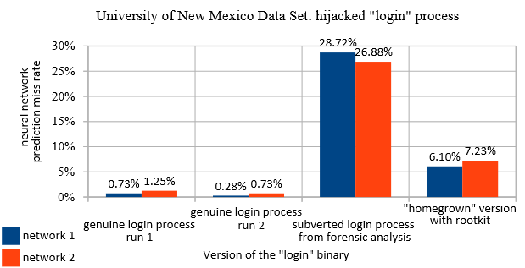
Blocks of Analysis – Neural networks (3)
Notes:
Here we can observe our neural network block of analysis results. For this test we used data from University of New Mexico. The prediction(predikszyn) rate for genuine(dżenuen) login binaries are presented in the first two blocks. As you can see the miss rate is very low - around 1%. The second two blocks, however, shows the prediction rate for subverted binaries. It is clearly much higher - almost 30% and around 7%. Therefore(defor), base on this results, we can tell that something is not right. The miss rate has changed drastically and we need to take some what exacly is going on on that host.

Slide 20
Agenda
Introduction
System Architecture
Blocks of Analysis (BAs)
Petri nets
Machine learning
Neural networks
Graph Clustering algorithms
Statistical anomaly detection
WSO2
Notes:
Next of BA(be ej) from our list is modul with solution based on Graph Clustering algorithms.

Slide 21
Blocks of Analysis – Graph Clustering algorithms
Detects: malware, network anomaly/attacks
Which attacks are detected: network attacks
Sensors: network device, system daemons, ntdump, flow-tool
Data: NetFlow
Notes:
Block of Analysis detect anomalies, attacks and malware in network.
BA detect attack in network traffic.
Sensors for BA are network devices, system demons and many other.
Block of Analysis uses Netflow data to analysis.

Slide 22
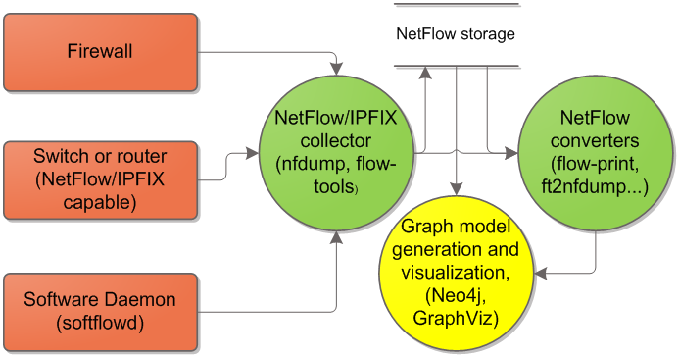
Network flows (NetFlows) – collecting data for graph based model
NetFlow/IPFIX processing general schema
Notes:
Graph based algorithms use network flow data form of netflow or ipfix records collected from various sources located in monitored network. The source of data could be firewall, network switches or routers, and in some cases software daemons monitoring particular hosts or virtualized infrastructre. NetFlows are collected by FlowCollectors in periodical way (e.g. every 5 minutes), stored and further process. Finally the graphical representation of netflows is build and further analysis conductef

Slide 23
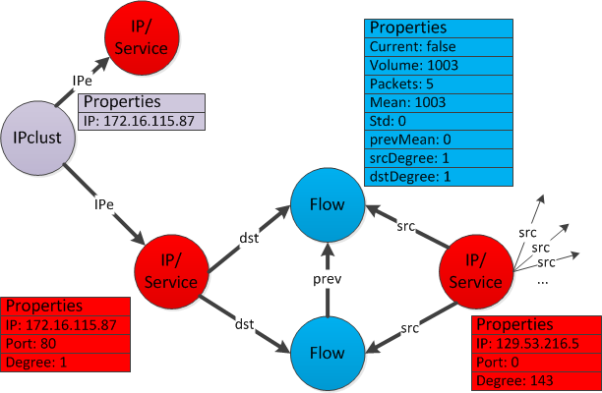
Network flows (NetFlows) – graph representations
Notes:
The idea of graph model for netflows is to build social network of communicating hosts – clients and services and observe how the properties of graph, representing the interactions between them, are changing over time. Additionally(adyszynli) some vertices are clustered togather using some basic features such like IP for example. The model is stored in graph database (Neo4j) and analyzed by means of queries in Cypher(sajfer) language. Client and services are represented by IP/Service nodes – the client has port number set to zero in our convention and the service other then zero. On one host there could be multiple services or some host may be client and service provider in the same time, in such cases we use Ipclust node to represent that fact.
The final graph model proposition for NetFlow representation is the result of trade of between simplicity and technical constraints of graph databases in particular Neo4j. Information about the flows could be stored as edge properties but in such a case the database queries in Cypher language would be over complicated (because of additional where constraints) and there would be a problem with storing sequences of netflow records along with accompanying historical data. In some cases adding new vertex is also faster than modifying properties of existing edges.

Slide 24
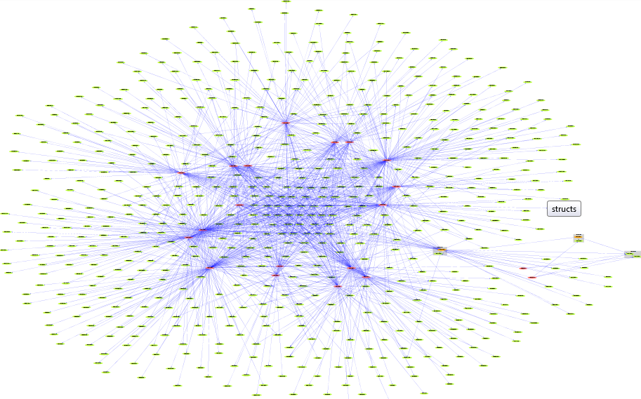
Examples of simplified NetFlow graphs
DARPA sets
SMTP
HTTP and SSH
Notes:
On the left HTTP and SSH traffic on the right SMTP. Red nodes are client nodes, green service nodes, orange are clients that are placed on the same host as service (e.g. SMTP server is usually a client and a server in the same time).

Slide 25
Querying the GraphDB – example
Identification of services listening on high ports and their clients
Cypher query:
MATCH (ip:IPclust)-->(s:IPnode)--> (f:Flow {current:true})<--(d:IPnode)
WHERE d.port >1024
RETURN DISTINCT ip.ip,d.ip;
s.Ip (source IP) | d.Ip (dest. IP)
172.16.114.168 | 194.27.251.21
172.16.114.168 | 197.182.91.233
172.16.114.168 | 195.115.218.108
172.16.114.50 | 194.27.251.21
172.16.114.50 | 197.218.177.69
172.16.114.50 | 195.115.218.108
172.16.114.50 | 196.37.75.158
172.16.114.50 | 195.73.151.50
172.16.114.50 | 197.182.91.233
172.16.114.50 | 199.174.194.16
Table with information only about the host initiating the connection
Notes:
We can use our database to search for particular kind of traffic patterns e.g. we can monitor if there are any services on high ports there are used by our employees.

Slide 26
Agenda
Introduction
System Architecture
Blocks of Analysis (BAs)
Petri nets
Machine learning
Neural networks
Graph Clustering algorithms
Statistical anomaly detection
WSO2
Notes:
Last of BA in ours list is modul with solution based on Statistical(Statistikal) anomaly detection

Slide 27
Blocks of Analysis – Statistical anomaly detection
Detects: network anomalies/attacks, malware
Which attacks are detected: viruses, action scanners, malware (botnets)
Sensors: network device, softflowd, nfcapd
Data: src(dst), address(port), flows length, packets, bytes, in(out)-degree
Notes:
Block of Analysis detect anomalies, attacks and malware in network.
BA detect attack such as viruses, action scanners, malware ( run in botnetu).
Sensors for BA are network devices and other examples on this slide.
Block of Analysis uses all of data presented on this slide data to analysis.

Slide 28
Agenda
Introduction
System Architecture
Blocks of Analysis (BAs)
Petri nets
Machine learning
Neural networks
Graph Clustering algorithms
Statistical anomaly detection
WSO2
Notes:
Next step in our presentation is software named WSO2(dabliu, s, oł, tu).

Slide 29
WSO2 (1)
The user application is based on the WSO2 system
Comprehensive tool for the analysis of event streams
Contains useful built-in components, some of which we use in SECOR):
CEP system
High performance engine to analyze events streaming (Esper or Siddhi)
Events monitoring system
Web-based management application
Convenient integration with other systems (RESTful HTTP, JMS, SOAP, files and e-mail messages sent as JSON, XML or text messages)
Notes:
WSO2 is complex and advanced software to correlation data and analysis. Most important parts of SECOR is based on WSO2.
We use in the project such as the WSO2 system functionality: CEP system, engine Siddhi(sadi), system to monitor events, web brouser to menage the aplication, and many other.

Slide 30
WSO2 (2)
Siddhi Query Language examples:
Notes:
On this slide we can see two Query examples of use Query language Siddhi(sadi).
First query give us events from stream BA3.
The event must have value of port equal 22 and title equal DDOS. The events is get from last one minute.
All events save into another stream name StreamyX.
Second query give us events from stream BA3 and BA2.
We colerate data from this to streams to one name StreamY.
The event must have value port equal 22 or 3389 and timestamp must match to rexp.
All events save into another stream name StreamyX.

Slide 31
Questions?
Contact information of Security Team in PSNC:
marek.pawlowski@man.poznan.pl (Marek Pawłowski)
security@man.poznan.pl
http://security.psnc.pl/en
Notes:
Questions?
*****
We have some time for questions.
*****
Thank you for the questions/the listening. If you would like to contact us, please write an email.
We also have a SECOR poster in the hall, so we can talk about the project during the coffee break.
It was a pleasure to talk to you.
***************************
Przykładowe odpowiedzi na trudne pytania:
***
This is a very good question.
*
Sorry, I did not hear you very well. Could you please repeat the question?
****
The answer is beyond the scope of the presentation, let’s discuss that later.
I think the answer would take too much time – let’s talk about it during the poster session / coffee break.
I am sorry but this was not done by me/by our team and I don’t have full knowledge about that. I will have to ask and will answer you later

Slide 32
This work was partially supported by Applied Research Programme (PBS) of the National Centre for Research and Development (NCBiR) funds allocated for the Research Project number PBS1/A3/14/2012 (SECOR).

