Slide 1
.Numerical Simulations of Metal Forming
Production Processes and Cycles by Using Heterogeneous Computing Infrastructures
Ł. Rauch, J. Liput, K. Imiołek, D. Król, J. Kitowski
ACC Cyfronet AGH
Department of Computer Science, AGH UST
CGW’14
Kraków, Poland, October 27-29, 2014
Notes:
*
Good morning/afternoon/evening everyone. My name is Jakub Liput, I am from Academic Computer Centre Cyfronet and I am delighted to be here today to talk to you about Numerical simulations of metal forming production processes and cycles by using heterogeneous computing infrastructures.
dopisać wydział dr Raucha, czy to tylko Cyfronet? w abstrakcie nie ma -> Faculty of Metals Engineering and Industrial Computer Science

Slide 2
Agenda
Problem statement
  Innovative Study of Metallurgy in Domain Grid
  Problem statement and the main objective
System components
  ManuOpti
  Scalarm
Integrated solution
  Architecture overview
  User interface
Conclusions
Notes:
*
Firstly, I will talk about innovative study of metallurgy in domain grid that will be developed under the PL-Grid NG project and issues that will be solved by our service.
Then I will look at some systems that will help us with reach our goal and next I will present concept of integrated solution by presenting overview of an architecture and user interface.
Finally I will summarize whole presentation with conclusions.

Slide 3
Innovative Study of Metallurgy
Part of PLGrid NG
  Next Generation Domain-Services
  in PL-Grid Infrastructure for Polish Science
  European Regional Development Fund program
  no. POIG.02.03.00-12-138/13
Metal processing technologies
  Metal forming procedures and production cycles optimization
Use cases examples
  Production cycles of rods and rails optimization
  Simulating processes of forging, extrusion, drawing or flow forming
Notes:
Our work is carried out as a part of PLGrid NG project, which aims at creating various domain grids dedicated to many scientific disciplines. The PLGrid NG project is funded by European Regional Development Fund program.
The service we are creating is a realization of a metallurgical grid, which will be used to study metal forming procedures and production cycles with optimization of these processes.
Example of use case in this area is the optimization of production processes of rods and rails, which can use simulation of processes like forging, squeezing, drawing or flow forming.

Slide 4
Problem statement
Modern design of production processes
in metal forming industry
  Sophisticated numerical procedures
  Advanced optimization methods
Heterogeneous software
  Commercial or in-house codes
  Incompatible applications interfaces
  Different operating systems and architectures
Heterogeneous computational resourecs
  HPC infrastructures for time-consuming applications
  Private servers and workstations for licensed software
Notes:
Modern design of production processes and cycles in metal forming industry is based on sophisticated numerical procedures integrated with advanced optimization methods.
The software used for numerical simulations is delivered in a form of different commercial computer systems or in a form of in-house codes usually implemented by different academic and research institutions. They may be licensed differently.
Most of these systems, dedicated to simulation of various production processes, uses different formats of input and output files, so they cannot be combined together without additional effort.
Moreover, sometimes software can run only on specific operating system or computer architecture.
Apart from the problem of software heterogenity, computational resources used for running simulations can be different. Time consuming applications need High Performance Computing infrastructures while some software license can allow installation only in few workstations.

Slide 5
The main objective
Create computer system, which allows user to:
Design metal forming production processes and cycles
Execute computations in heterogeneous environment
Trace optimization process
Analyse results
All without knowledge about specific applications and computational resources.
Notes:
In order to solve these issues, we set the objective of creating computer system, which allows end-user to:
design metal forming production processes and cycles with convenient GUI,
execute computations related to created processes in heterogeneous environment,
trace optimization process, which will be done automatically, based on simulations result,
and finally to analyse results - not only with data tables but also with sophisticated analysis methods.
All of this tasks should be done by user without knowledge about specific applications and computational resources.

Slide 6
System components
ManuOpti
  Integrator of numerical tools used for metallurgical production processes simulations
  Lack of support for heterogeneous HPC infrastructures
Scalarm
  Platform for data farming on heterogeneous computational resources
  Lack of support for many heterogeneous domain-specific applications integration
Target solution will be synergy of both systems, that will be extended to meet metallurgical grid requirements.
Notes:
At the moment, there are two solutions that support separate parts of presented tasks:
First one is ManuOpti - an integrator of numerical tools used for metallurgical production processes simulations, and second is Scalarm - platform for data farming on heterogeneous computational resources.
While ManuOpti allows interoperability of metallurgical simulation software, it lacks support for High Performance Computing infrastructures. On the other hand, Scalarm does not help user to integrate heterogeneous software and is not domain-specific like ManuOpti.
Basing on these two systems we want to integrate them to create synergy of both systems, that will be extended to meet metallurgical grid requirements.

Slide 7
ManuOpti
Integration of heterogeneous software
Production processes and cycles optimization
ManuOpti
Notes:
As was said before, ManuOpti takes care of heterogeneous software integration. What is more it can optimize production processes and cycles.

Slide 8
ManuOpti
Integration of heterogeneous software
Production processes and cycles optimization
ManuOpti
Process specification
with desktop GUI
Notes:
ManuOpti user starts with desing of a metal forming production cycle model through desktop application GUI.

Slide 9
ManuOpti
Integration of heterogeneous software
Production processes and cycles optimization
ManuOpti
Execution delegation
Notes:
Each element of a process can be then computed on external server or on the user’s computer.

Slide 10
ManuOpti
Integration of heterogeneous software
Production processes and cycles optimization
ManuOpti
Input/Output conversion
Notes:
Communication between heterogeneous applications is handled by ManuOpti using format converters.

Slide 11
ManuOpti
Integration of heterogeneous software
Production processes and cycles optimization
ManuOpti
Process optimization
Notes:
After computations, results are used to optimize processes, and production cycle can be then repeated.

Slide 12
ManuOpti
Integration of heterogeneous software
Production processes and cycles optimization
ManuOpti
Results analysis
Notes:
Finally, system’s user can read results.

Slide 13
Scalarm
Complete data farming process support
Heterogeneous computational resources usage
Scalarm
Grid
Clouds
Servers
Notes:
Second component - Scalarm, is a complete data farming platform, that can use heterogeneous computational resources to perform computations.
In short, data farming process consists of execution of many simulations that differs only in input parameter space to obtain interesting and sometimes unexpected view at the problem studied.

Slide 14
Scalarm
Complete data farming process support
Heterogeneous computational resources usage
Scalarm
Grid
Clouds
Experiment and base parameter space definition via web GUI
Servers
Notes:
In Scalarm, whole process starts by defining experiment and base parameter space with web user interface.

Slide 15
Scalarm
Complete data farming process support
Heterogeneous computational resources usage
Scalarm
Grid
Clouds
Parameter sets generation
Servers
Notes:
Then Scalarm deals with the generation of parameter sets for many simulations.

Slide 16
Scalarm
Complete data farming process support
Heterogeneous computational resources usage
Scalarm
Grid
Clouds
Simulations execution
Servers
Notes:
And these simulations can be executed on various computing resources - like grid, various cloud services and single servers.

Slide 17
Scalarm
Complete data farming process support
Heterogeneous computational resources usage
Scalarm
Grid
Clouds
Parameter space modification based on results
Results analysis
Manual parameter space modification
Servers
Notes:
After getting partial results, user can analyse them and perform parameter space modification to better determine the direction of research.

Slide 18
Scalarm
Complete data farming process support
Heterogeneous computational resources usage
Scalarm
Grid
Regression trees
Pareto charts
Interaction charts
Bivariate analysis
Output statistics
Clouds
Servers
Notes:
Results can be analysed with regression trees, pareto charts, interaction charts, with bivariate analysis and other output statistics presented on charts.

Slide 19
Integrated solution - architecture overview
Wide range of resources available
Advanced computational tasks monitoring
ManuOpti
Grid
Clouds
Scalarm
Servers
Notes:
As was said before - these systems solve separate parts of metallurgical production processes simulations. Therefore, we proposed synergy of both systems. It will provide metallurgical-specific tools, but also will support wide range of computational resources and provide advanced computational tasks monitoring.
----
As was before, work with system starts with specification of production processes and cycle.
ManuOpti, instead of using servers with software directly, delegates execution of tasks to Scalarm. Every part of process can be described in Scalarm Definition Language. If few processes computations can be simulated on the same computational resource, they can be send together as one Execution Definition to Saclarm.
Scalarm acts as middleware and sends simulations with generated parameter space to heterogeneous infrastructures and monitors the execution status.
After simulations completion, also partial, results are send back to ManuOpti and then it can perform optimizations with its libraries.
Because task of optimization can be time-consuming process, it can be also delegated to Scalarm and executed on external HPC.
After completing simulations, user can read results as in primary ManuOpti system.

Slide 20
Integrated solution - architecture overview
Wide range of resources available
Advanced computational tasks monitoring
ManuOpti
Grid
Process specification with classic ManuOpti desktop GUI
Clouds
Scalarm
Servers
Notes:
As in classic ManuOpti, work with system will start with specification of production processes and cycle with GUI.
----
Scalarm acts as middleware and sends simulations with generated parameter space to heterogeneous infrastructures and monitors the execution status.
After simulations completion, also partial, results are send back to ManuOpti and then it can perform optimizations with its libraries.
Because task of optimization can be time-consuming process, it can be also delegated to Scalarm and executed on external HPC.
After completing simulations, user can read results as in primary ManuOpti system.
By integrating ManuOpti with Scalarm
wymienić konkretne programy używane na gridach przez manu opti?
in local-only version of manuopti we have only few single servers available to perform computations - it is not sufficient for large processes with many process parts, each with resource-consuming operations
we plan to increase the number of regular users to 50 [to może być za mała liczba, żeby zrobić jakiekolwiek wrażenie...]

Slide 21
Integrated solution - architecture overview
Wide range of resources available
Advanced computational tasks monitoring
ManuOpti
Grid
Clouds
Process parts specification
Scalarm
Servers
Notes:
ManuOpti, instead of using servers with software directly, will delegate execution of tasks to Scalarm. Every part of process will be described in Scalarm definition language.
// If few processes computations can be simulated on the same computational resource, they can be send together as one Execution Definition to Saclarm.

Slide 22
Integrated solution - architecture overview
Wide range of resources available
Advanced computational tasks monitoring
ManuOpti
Grid
Clouds
Execution information
Simulations results
Scalarm
Servers
Notes:
Scalarm will perform simulations on appropriate computational resources. During the execution, resources will be monitored by Scalarm, providing important information about simulations progress. Then simulation results will be send back to ManuOpti.

Slide 23
Integrated solution - architecture overview
Wide range of resources available
Advanced computational tasks monitoring
ManuOpti
Grid
Results analysis
Clouds
Scalarm
Servers
Notes:
Our service user will be able to read results in classic ManuOpti interface.

Slide 24
Integrated solution - architecture overview
Additional results analysis methods made possible by Scalarm
ManuOpti
Grid
Clouds
Analysis data
Scalarm
Servers
Notes:
Moreover, as Scalarm provides some analysis methods, data about analysis can be used by ManuOpti

Slide 25
Integrated solution - architecture overview
Additional results analysis methods made possible by Scalarm
ManuOpti
Grid
Final analysis view
Clouds
Scalarm
Servers
Notes:
To show user various Scalarm’s analysis views.

Slide 26
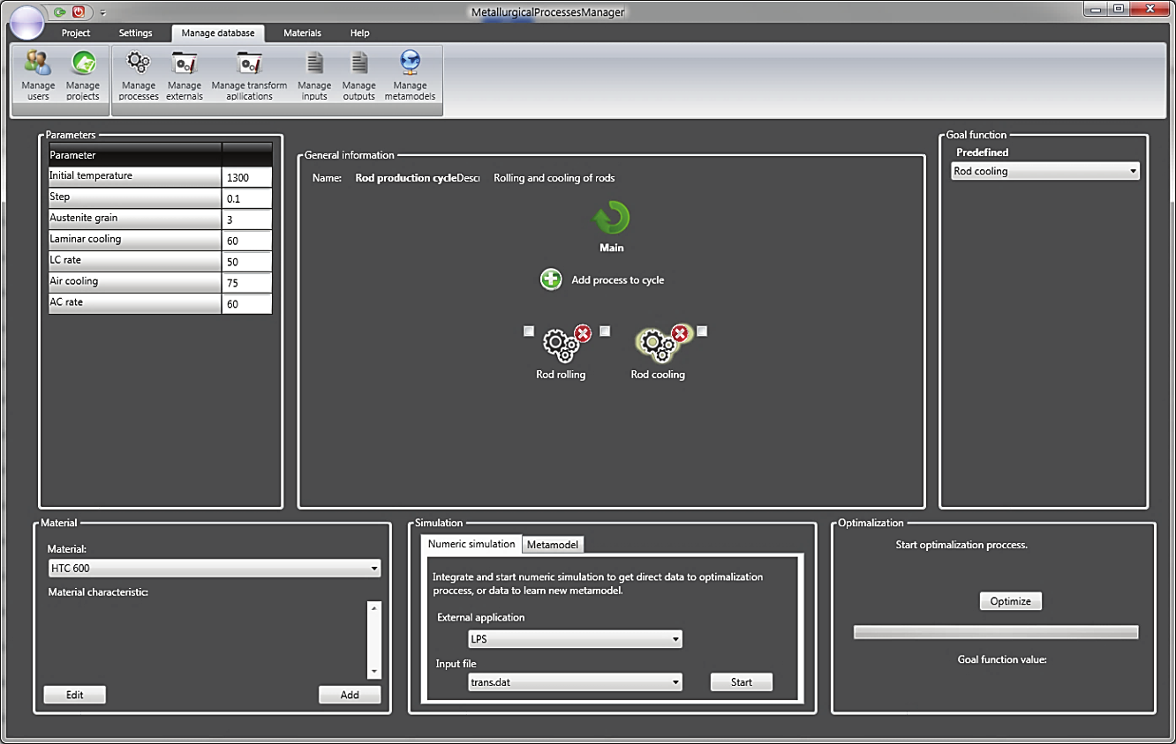
User interface
Notes:
The user interface of service will be based on primary ManuOpti desktop application GUI. Beside whole process specification with convenient design view it will support additional detailed external computational infrastructures configuration and OpenID login.
Service’s window consists of ribbon menu and various panels:

Slide 27
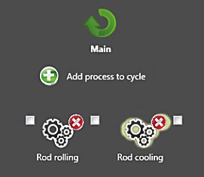
User interface
Production cycle design
Notes:
Production cycle designer,

Slide 28
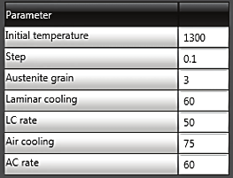
User interface
Processes parameters
Notes:
Process parameters configuration,

Slide 29

User interface
Goal function
Notes:
Process goal function specification,

Slide 30

User interface
Material specification
Notes:
Material specification and editor,

Slide 31
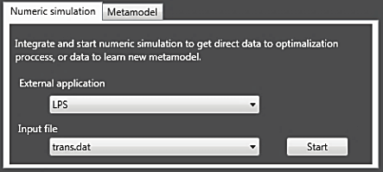
User interface
Simulation configuration
Notes:
Simulation configuration,

Slide 32
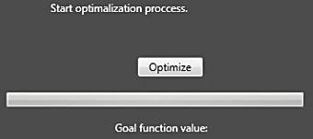
User interface
Optimization
Notes:
And optimization controller.

Slide 33
Conclusions
Applying advanced computing infrastructures to design metal forming production cycles using data farming middleware
New use cases due to possibility to execute extremely time consuming processes
  Optimized 3-stage flange forging process with use of Marc software
  Simulation of forging, extrusion, drawing and flow forming took few days on workstations
First release of service planned on Q1`2015
Notes:
Summing up, developed service will allow to apply advanced computing infrastructures to design metal forming production cycles, which was not possible to this moment.
Thanks to that, new use cases appeared like optimized 3-stage flange forging process with use of Marc software.
Also simulating processes like forging, extrustion, drawing and flow forming will be able to complete much quicker as before they took few days on workstations.
We plan first release of service on first quarter of 2015.
ogólnie - dlaczego są czasochłonne - w tych procesach podz. symulacji num. -> są duże odkształcenia -> deformacja -> remeshing
-> kolejna siatka, interpolacja, czas symulacji num. bardzo się wydłucza -> siatki na miliony elementów->uklad elementów mln na mln
forging -> młot spadowy -> bardzo duża prędkość odkształcenia, strain rate E z kropką -> bardzo wysoki, strain rate
extrusion -> wyciskanie lejek -> bardzo duża deformacja lokane
<<podobne>>
ciągnienie -> biorę materiał i przeciągam przez małe oczko, redukcja średnicy
problem: meshowanie lejka E ze strzałką (strain) jest wysoki lokalnie, gęsta siatka
flow forming ->
extrusion 3d
marc (sam marc) prawdopodobnie na TASK mentat

Slide 34
Contact
Metallurgy Domain Grid Director, Metallurgy expert:
Lukasz Rauch: lrauch@agh.edu.pl
Technical questions about systems integration:
Jakub Liput: j.liput@cyfronet.pl

